Slide 1

MBEYA UNIVERSITY OF SCIENCE AND TECHNOLOGY
COLLEGE OF INFORMATION AND COMMUNICATION TECHNOLOGY
DEPARTMENT OF ELECTRONICS AND TELECOMMUNICATION ENGINEERING
TITLE:EXPLAINABLE AI MODEL FOR PULMONARY EDEMA DETECTION IN CHEST X-RAY IMAGES
Student Name: BONIFACE BEN SANKWA
Registration number: 22100934340091
Supervisor: Dr. NYATEGA
TITLE: EXPLAINABLE AI MODEL FOR PULMONARY EDEMA DETECTION IN CHEST X-RAY IMAGES

Slide 2
PROJECT OBJECTIVES
Main Objective
To develop an Explainable AI system for detecting pulmonary edema in chest X-ray images, capable of providing diagnostic results along with visual explanations of the regions used for prediction.
Specific Objectives
Collect and preprocess chest X-ray datasets.
Train a CNN model for detection.
Apply Explainable AI techniques.
Evaluate model performance and Develop a simple web interface.
Notes:
Specific Objectives
Study pulmonary edema features in X-ray images.
Collect and preprocess chest X-ray datasets.
Train a CNN model for detection.
Apply Explainable AI techniques.
Evaluate model performance and
Develop a simple web interface to display predictions and heatmaps.

Slide 3
RESULTS DISCUSSION

Slide 4
1. Model Performance
Metric | Value | 95% Confidence Interval
AUC-ROC | 0.917 | 0.89 – 0.94
Accuracy | 85.0% | 79.5% - 89.5%
Sensitivity | 82.0% | 73.5% -88.5%
Specificity | 88.0% | 80.5% - 93.5%
Precision | 87.2% | 79.5% - 92.5%
Notes:
Area Under the Receiver Operating Characteristic Curve (AUC-ROC)

Slide 5
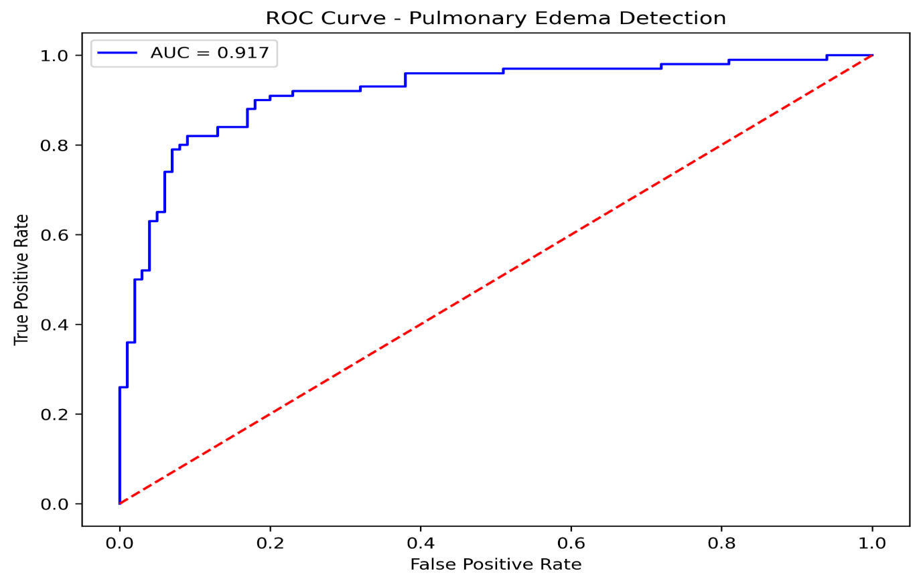
Notes:
Area Under the Receiver Operating Characteristic Curve (AUC-ROC)

Slide 6
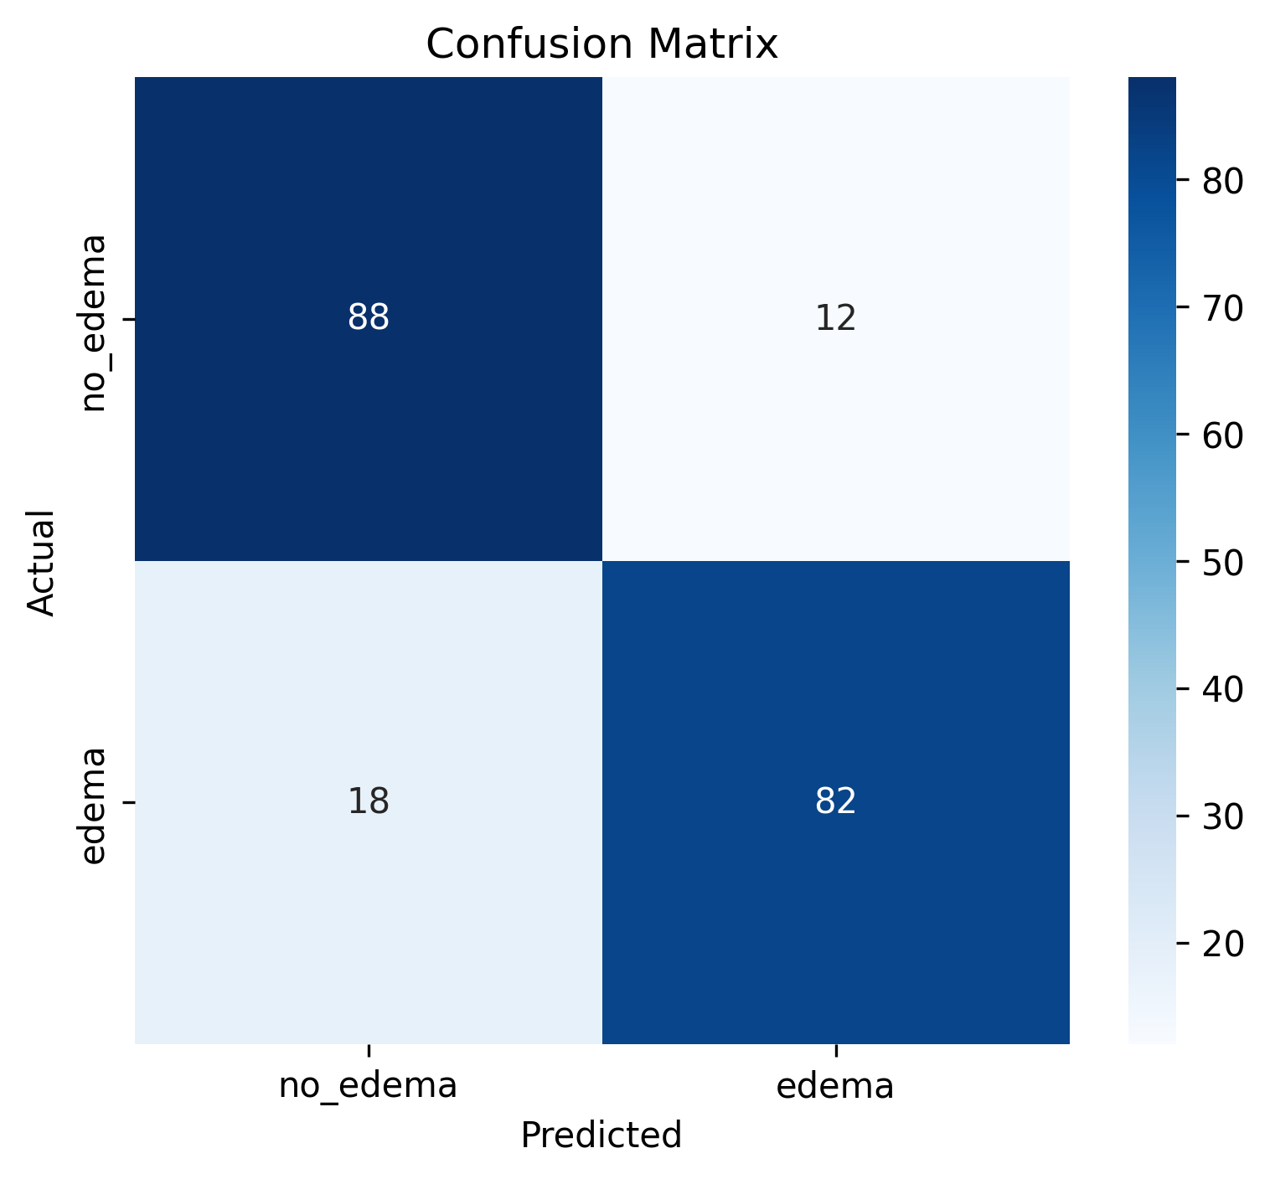
2. Classification Metrics
Notes:
• Sensitivity: 82% • Specificity: 88% • Precision: 87.2% • Test set: TN=88, TP=82, FP=12, FN=18

Slide 7
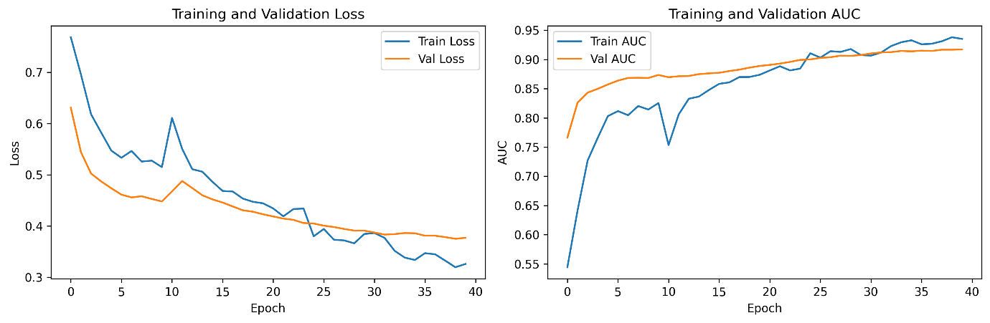
3. Training Analysis
Trained for 40 epochs
Validation loss decreased from 0.63 to 0.38
Validation AUC reached 0.917
No significant overfitting observed.
Notes:
Training curves over 40 epochs (Figure 3) demonstrate successful model learning. Validation loss decreased from 0.63 to 0.38, while validation AUC increased from 0.77 to a peak of 0.917 at epoch 39. The close alignment between training and validation curves indicates no significant overfitting
Area Under the Receiver Operating Characteristic Curve (AUC-ROC)

Slide 8
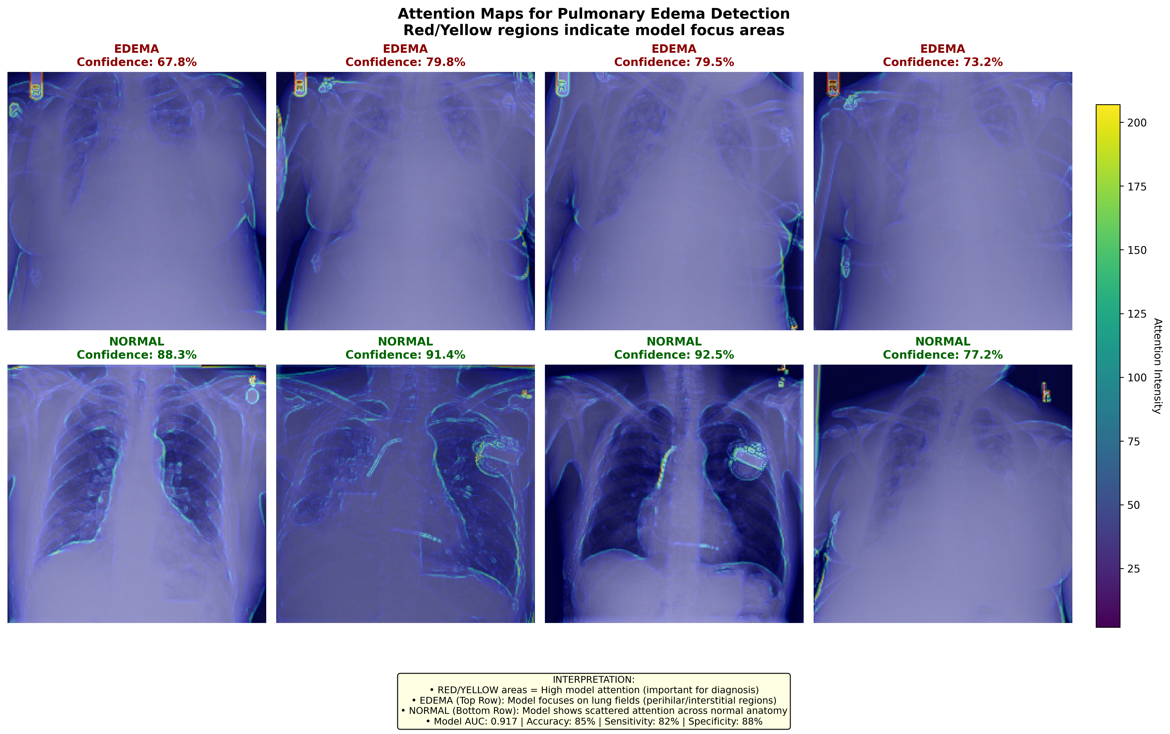
4. Explainability Analysis
Model focused on perihilar/interstitial lung regions in edema.
Normal cases showed diffuse attention.
Confidence: 61.0%–92.5%
Notes:
Grad-CAM attention maps (Figure 4) revealed distinct patterns between edema and normal cases. For edema cases (top row), the model focused on perihilar and interstitial lung regions, which is consistent with radiological findings of pulmonary edema (Milne et al., 2012). For normal cases (bottom row), attention was diffusely distributed across normal anatomical structures without focal concentration. Confidence scores for correctly classified cases ranged from 61.0% to 92.5%.

Slide 9
Conclusion
DenseNet121 + Grad-CAM achieved reliable pulmonary edema detection.
XAI improves transparency and clinical confidence.
Suitable as decision support for radiologists.
Notes:
Area Under the Receiver Operating Characteristic Curve (AUC-ROC)

Slide 10
THANK YOU
Notes:
Area Under the Receiver Operating Characteristic Curve (AUC-ROC)

